Slide 1
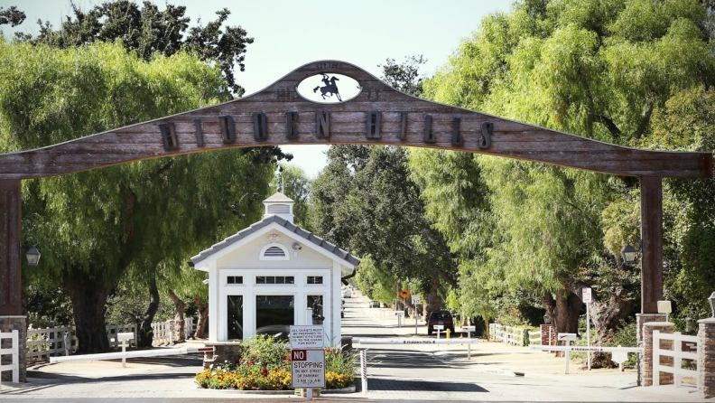
Strategic Plan
Hidden Hills Community Association

Slide 2
Table of Contents
Vision
Mission
Strategic Priorities 2020-2021
Community Principles
Core Values
Organizational Chart

Slide 3
Vision

Slide 4
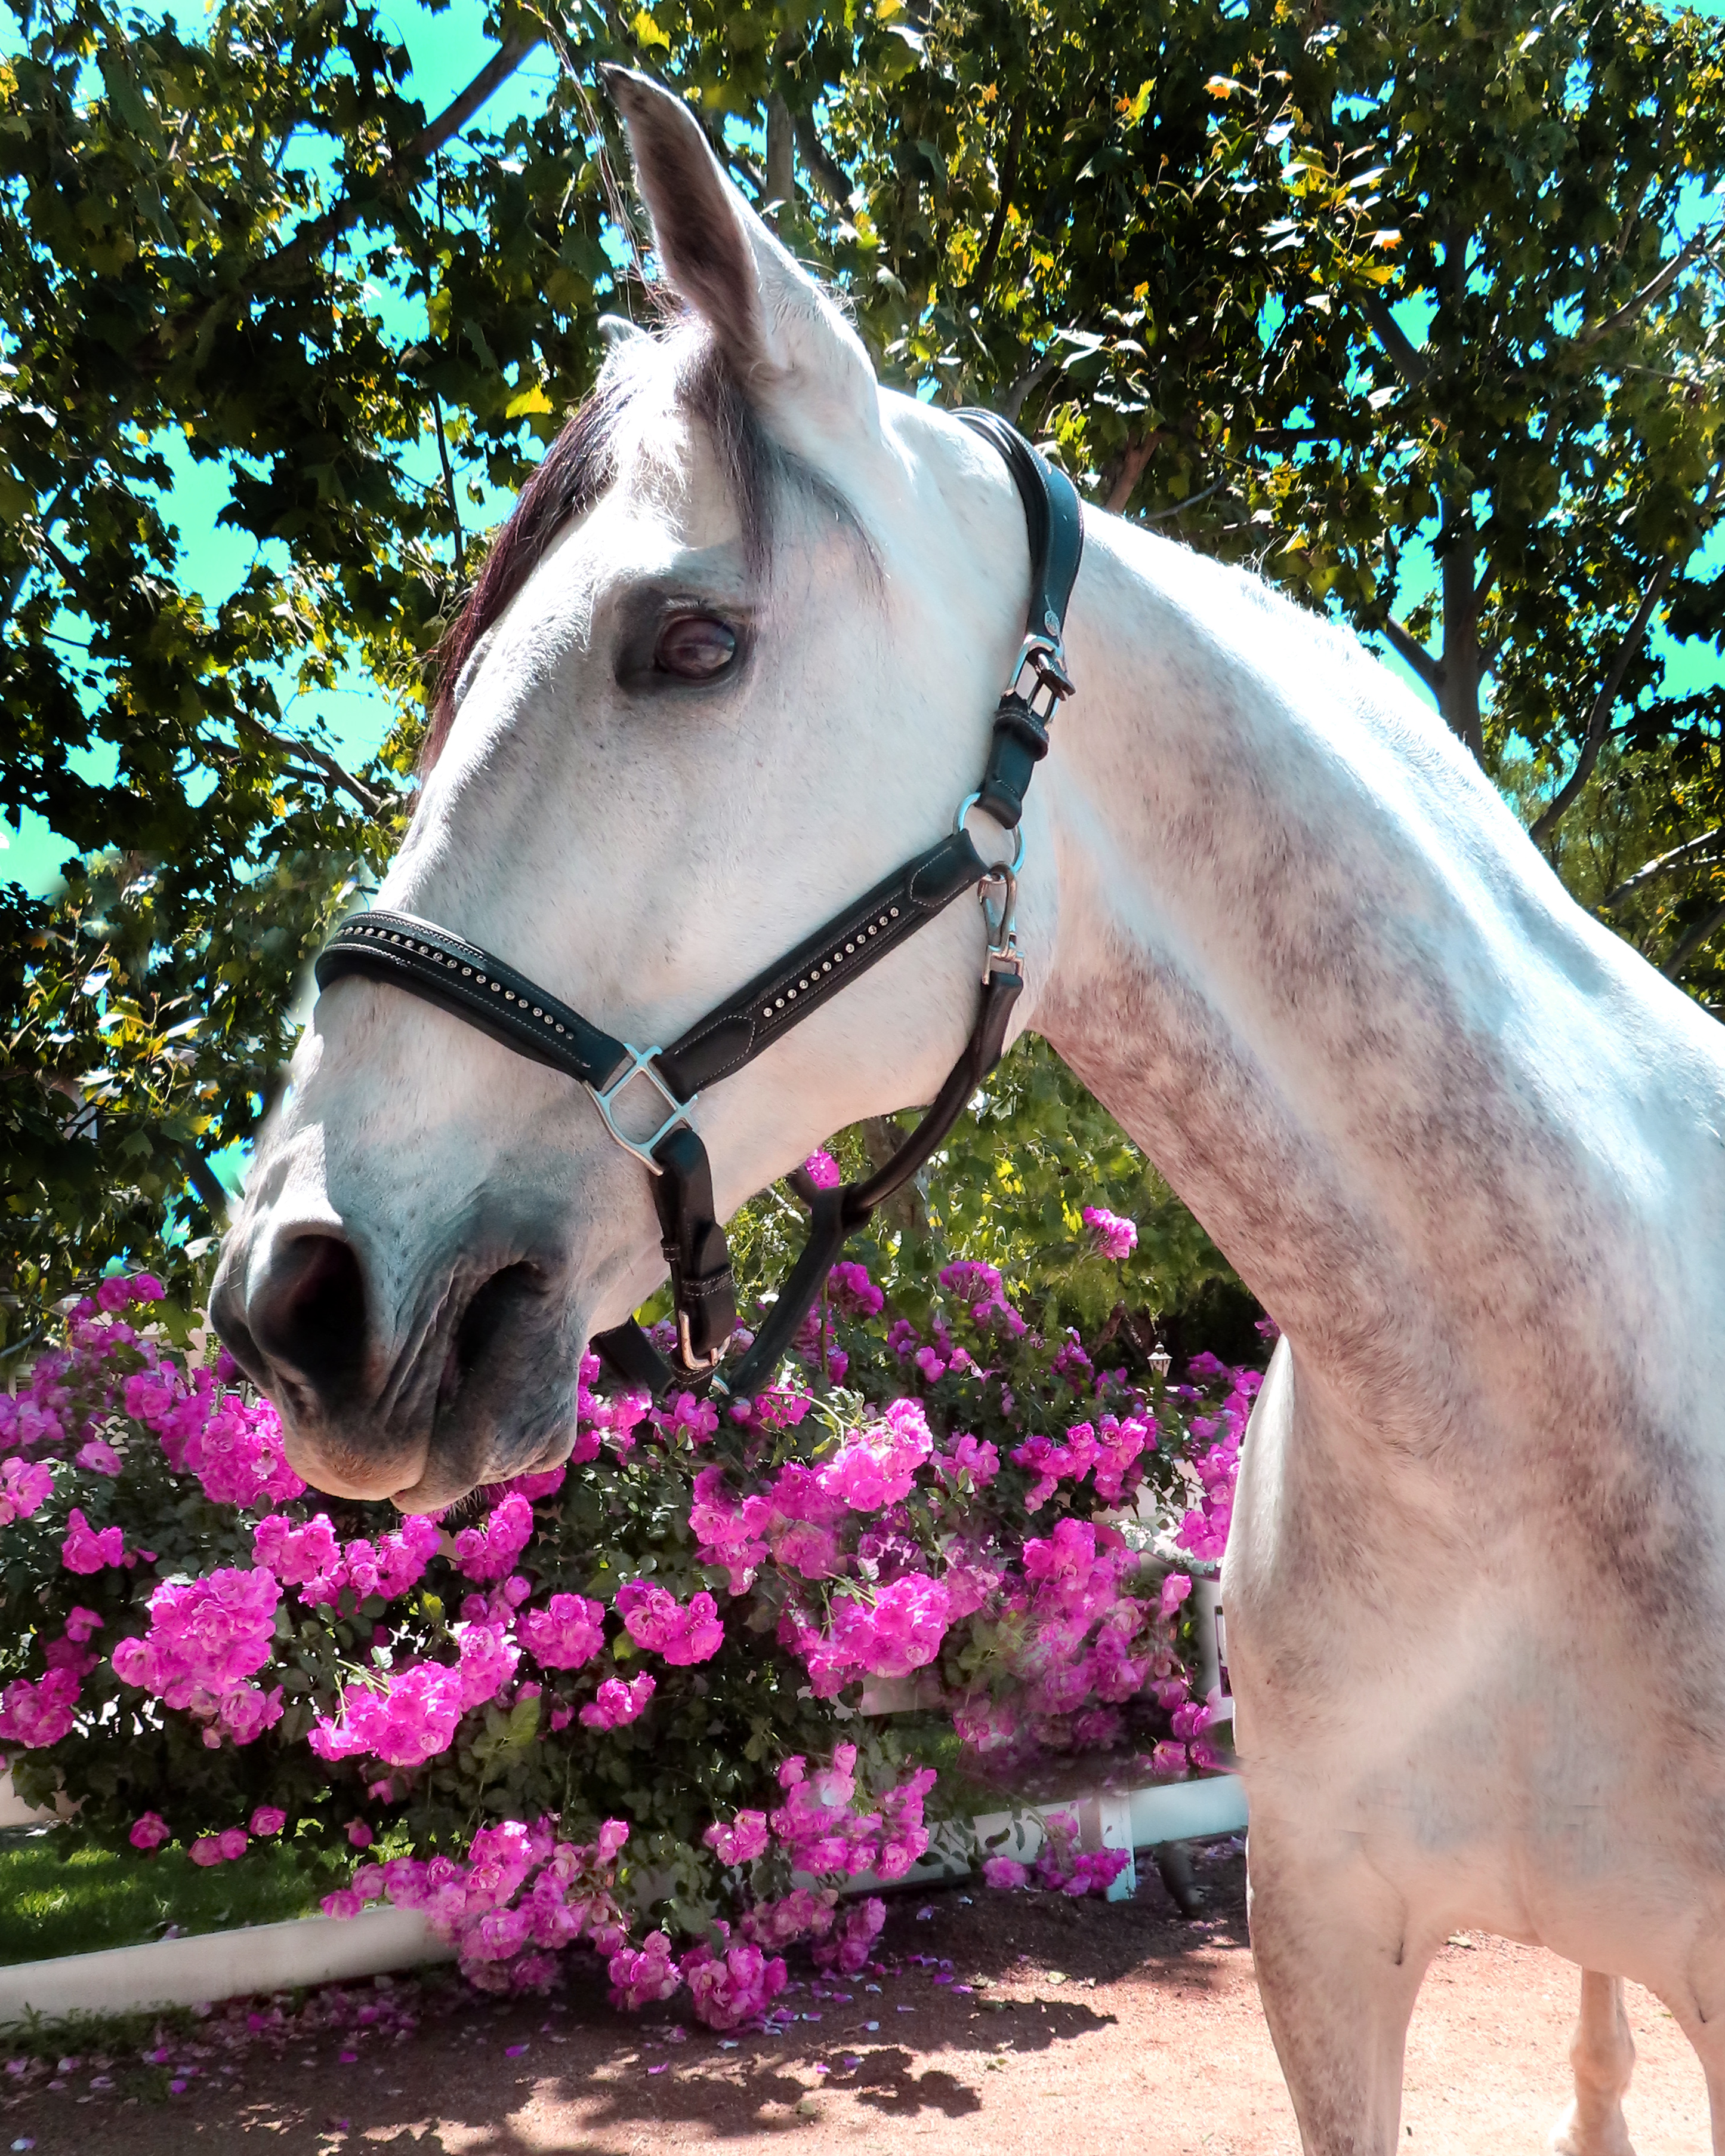
Vision
A rural equestrian-based community that promotes neighborhood connections.

Slide 5
Mission Statement

Slide 6
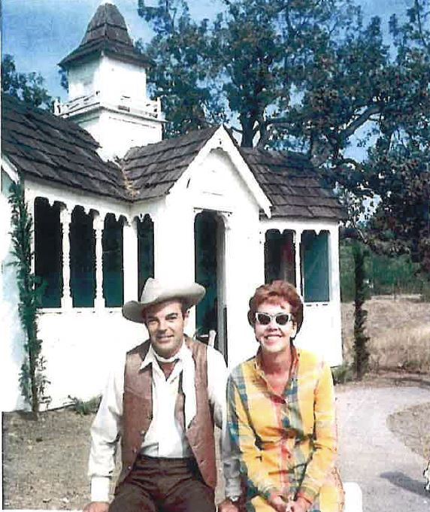
Mission Statement
To create and maintain a distinctive, rural equestrian-based environment with community-oriented events and gathering places, be responsive to the community’s needs, and provide open homeowner communications.

Slide 7
Strategic Priorities
FY 2020-21

Slide 8
Strategic Priorities FY 2020-21
Update Hidden Hills Governing Documents
On-Site Operations and Office Infrastructure

Slide 9
Update Hidden Hills Governing Documents
STRATEGIC PRIORITIES FY 2020-21
Covenants, Conditions &Restrictions
Bylaws
Rules & Regulations
Architectural Standards
Election Rules
Committee Charters

Slide 10
On-Site Operations and Office Infrastructure
STRATEGIC PRIORITIES FY 2020-21
Implement written systems, procedures, office protocols, and reports for each critical function of the Association
Adopt and implement the Job Qualifications and Descriptions provided for each role
Create an annual calendar and execute the Board-approved Operating and Reserve Projects in the Annual Budget
Produce the monthly Management Report, include it in each Board Package and present it at each Board Meeting
Create and present an amended budget and operational plan at the September Board Meeting
Improve the website to provide access to current data, including events, meetings, and key association documents
Create the preliminary budget, annual calendar, and operational plans for Fiscal Year 2022

Slide 11
Community Principles

Slide 12
Community Principles
Distinctive, Rural Equestrian-Based Community
Community Gathering Places
Open Homeowner Communications
Inclusive Community Events
Solid Infrastructure & Operations
Effective Governance

Slide 13
Distinctive, Rural Equestrian-Based Community
COMMUNITY PRINCIPLES
Well designed and maintained common area parkways, streets, facilities, and trails reflecting a rural, equestrian-based environment
Preservation of the heritage and history of Hidden Hills
Consistent application of Architectural Standards throughout the community
Programs and policies reflecting an environmentally conscious community

Slide 14
Community Gathering Places
COMMUNITY PRINCIPLES
Focal points for Hidden Hills residents and guests that promote neighborhood connections
High quality safety and service standards for all community spaces
Branding of key areas
Provide facilities consistent with hosting Association and Community sponsored events

Slide 15
Open Homeowner Communications
COMMUNITY PRINCIPLES
Provide multichannel communications platforms and access to Association information, including events, meetings and key documents.

Slide 16
Inclusive Community Events
COMMUNITY PRINCIPLES
Collaborate with homeowners for community input in designing a variety of multi-cultural and generational experiences
Create events that promote neighborhood connections

Slide 17
Solid Infrastructure & Operations
COMMUNITY PRINCIPLES
High quality, well-trained, competent on-site staff
Accurate management reporting of relevant data to the Board
High value customer service orientation
Documented and clearly defined goals, duties, and responsibilities
Consistent implementation of processes, clear goal setting, and tracking mechanisms
Provide timely communications and follow-up
Create and maintain volunteer opportunities for homeowner participation
Appoint a cross-section of homeowners to serve on Committees
Establish disaster and emergency operations plan

Slide 18
Effective Governance
COMMUNITY PRINCIPLES
Maintain and monitor compliance with applicable laws and regulations
Consistent code and regulation enforcement
Demonstrate strong fiscal responsibility in the expenditures of Hidden Hills Association funds
Govern as a Board and not as individuals
Maintain structured policies and procedures that reflect accountability and measure necessary outcomes
Collaborate/communicate with homeowners to ensure prompt response to inquiries and adherence to Hidden Hills governing documents
Establish a “Reserve” policy and funding plan

Slide 19
Core Values

Slide 20
Core Values
The Governing Body & Management Team of the Hidden Hills Community Association commits to the following values:
Personal Integrity & Honesty
Productivity
Teamwork
Respect
Service to Others

Slide 21
Personal Integrity & Honesty
CORE VALUES
Adhere to the governing documents of Hidden Hills in a consistent manner
Do the right thing
Take responsibility for our decision and actions/inactions
Act in a professional and ethical manner
Deliver on our commitments and promises
Treat others in a fair and equitable manner
Take responsibility for mistakes and learn from them
Be dependable and reliable
Bring ideas and solutions, not just problems
Be transparent with members and each other

Slide 22
Productivity
CORE VALUES
Complete assigned tasks in a timely manner
Do the job right the first time
Do our best, going the extra mile
Develop core competencies and apply new knowledge
Do our “homework” and come prepared to meetings
Look for and implement ways to reduce costs and increase productivity
Own our decisions
Have an open mind and be willing to try new ideas
Think creatively and outside of the box, then take innovative actions

Slide 23
Teamwork
CORE VALUES
Concentrate on the greater good
Focus on “We” not “I,” and “us” not “me”
Share resources
Be willing to help others be successful and collaborate with others when appropriate
Keep team members informed
Celebrate team successes and recognize the contributions of others
Learn from setbacks without blaming or finding fault
Cooperate with others
Prioritize the “best interests” of Hidden Hills
Know your responsibilities and be an effective team member

Slide 24
Respect
CORE VALUES
Act in a kind, courteous and professional manner
Actively listen to others and strive to understand and respect their perspectives
Know our roles and responsibilities and respect the role and responsibilities of others
Respect diverse personalities, traits, and opinions
Follow the chain of command
Be an enthusiastic ambassador for Hidden Hills
Show up on time and be prepared
Support other team members and processes

Slide 25
Service to Others
CORE VALUES
Serve the community and homeowners with passion
Be friendly, courteous and positive
Provide fair, equitable service (in compliance with the governing documents)
Value and appreciate the homeowners, guests and volunteers
Provide a timely response and consistent customer service
Make decisions in your area of responsibility
Solve the problem
Act in an “ethical” and professional manner

Slide 26
Organizational Chart

Slide 27
Organizational Chart
General Manager
Events & Admin
* Admin. duties
* Events
Compliance & Architectural
* Rules Compliance and Enforcement
* Architectural Admin.
Various HH Staff and Contractors
*Architectural Consultant
*Finance
*Facilities
*Trails
*Office Operations
*Contractors
- Gate/Patrol Services
- Landscaping
Communications & Admin.
*Customer Service
* Website
*Newsletter
* Admin. duties
Legal Counsel

Slide 28
